Slide 1
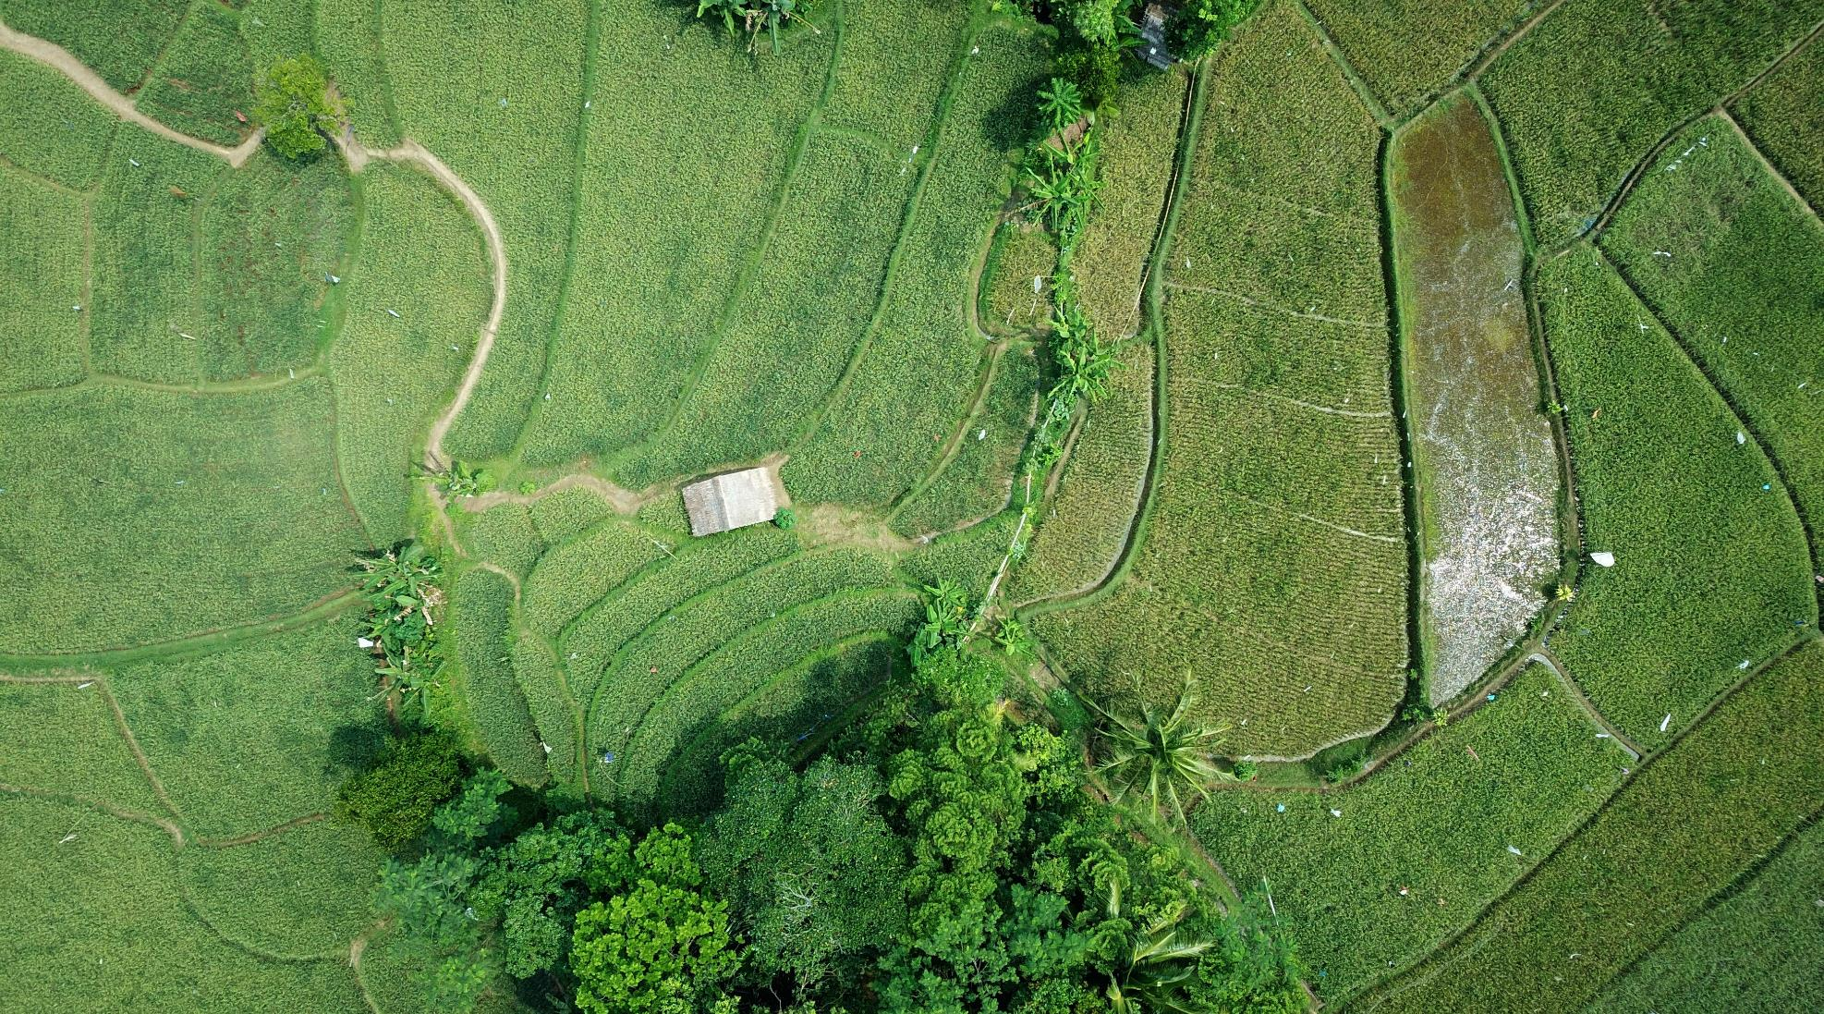

Optimizing the Agricultural Production

Slide 2
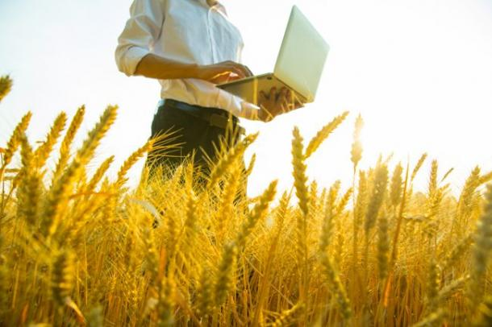
Agriculture
Agriculture is the science and art of cultivating plants and livestock.
The history of agriculture began thousands of years ago.
Future agriculture will use sophisticated technologies such as robots, temperature and moisture sensors, aerial images, and GPS technology.
These advanced devices and precision agriculture and robotic systems will allow farms to be more profitable, efficient, safe, and environmentally friendly.

Slide 3
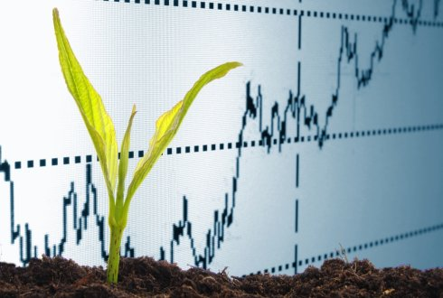
Problem Statement
Analysing and finding the optimal climatic condition and essential nutrients to plant and grow crops.
Using Unsupervised learning technique, clustering the crops based on hidden pattern in it.
Predicting the classifications of crop using Popular supervised learning method.
Verifying the prediction result using metrics like Confusion matrix and classification report.
Finally, Finding the optimal requirements for particular crops to check the models accuracy.

Slide 4
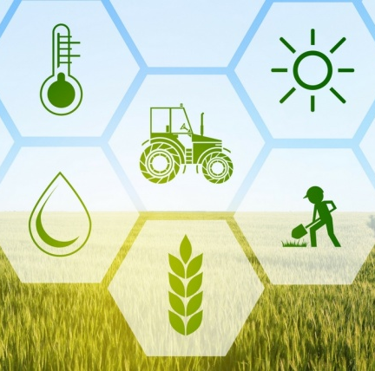
Factors helping to grow crops
N - ratio of Nitrogen content in soil
P - ratio of Phosphorous content in soil
K - ration of Potassium content in soil
Temperature - temperature in degree Celsius
Humidity - relative humidity in %
ph - ph value of the soil
Rainfall - rainfall in mm

Slide 5

Business Implications of the Project
Finding optimal requirements to cultivate a crop will help us to get high yield and good profit with lesser effort.
By data analysis, we can get insights like,
Optimal temperature for every crop.
Optimal N, K, P level for every crop.
Required rainfall for each crop.
Required temperature and ph level for every crop.

Slide 6
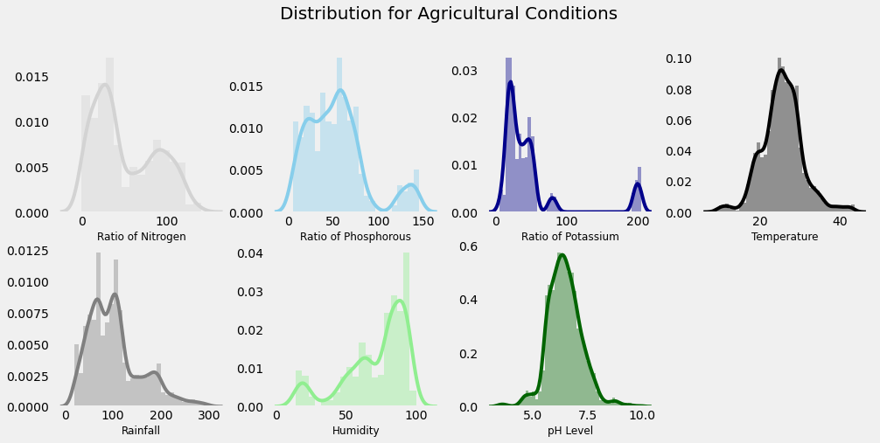
Data Analysis to find optimal requirments
Separately finding average requirements to cultivate all the crops.
Finding Min, Max, Avg value of each requirements which helps growing crops.
Finding which Summer, Winter, and Rainy crops and the required nutrients for each of them along with climatic condition.

Slide 7
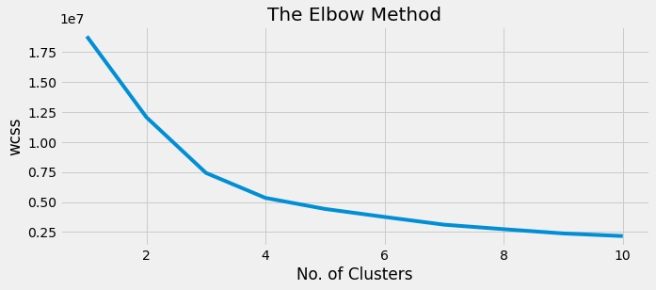
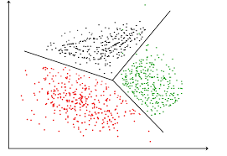
Clustering the similar Crops
Creating Clusters based on the input essential requirements using K-Means clustering algorithm.
Finding optimal cluster value using Elbow method
Determining the number of Clusters within the Dataset.
Based on the given conditions implementing Hard Clustering.

Slide 8
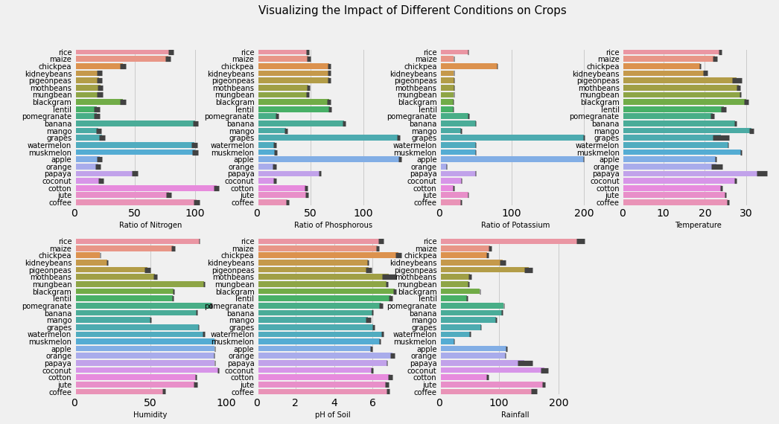
Visualizing the Impact of requirements on Crops

Slide 9
Predictive Modeling Building
Initially splitting the dataset into inputs (x) and targets (y).
Splitting the dataset into Train and test set.
Using Logistic Regression to do the predictions of the Crops.
It employs the use of the sigmoid function that can take any real-valued number and map it into a probability value between 0 and 1 to predict the output class.
There are two types of logistic regression: Binary and Multinomial.
Binary Logistic Regression deals with two categories whereas multinomial deals with three or more categories.

Slide 10
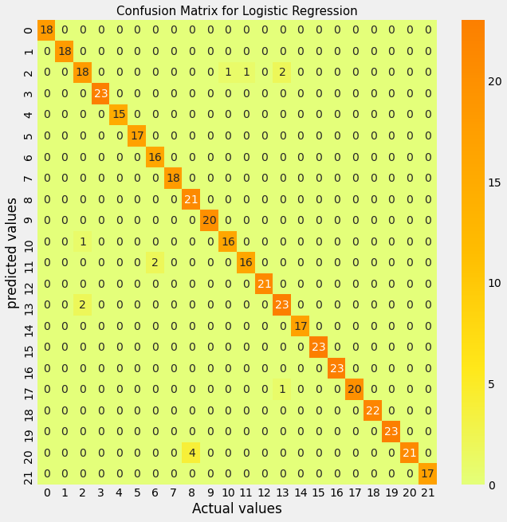
Prediction Result Analysis
Confusion Matrix
Through the Confusion Matrix we can see that the most of the predictions are correct.
By this we came to know that the selected Logistic Regression for the Prediction performed really Good.

Slide 11
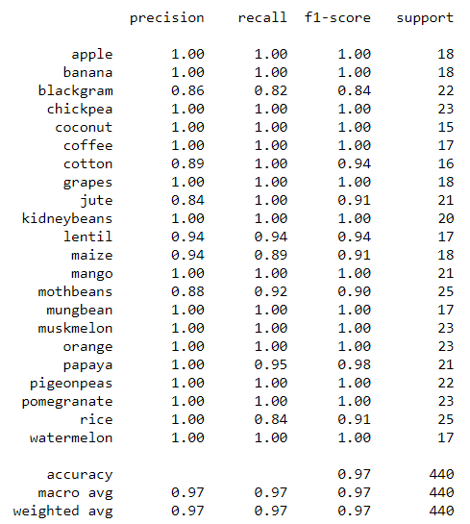
Prediction Result Analysis
Classification Report
From the classification Report we can see that the used Logistic regression performed really well and we got the accuracy as 97%.

Slide 12

Thank You

